Slide 1
Exit Ticket Answers
ECEN 4/5632 Theory and Application of Digital Filters

Slide 2
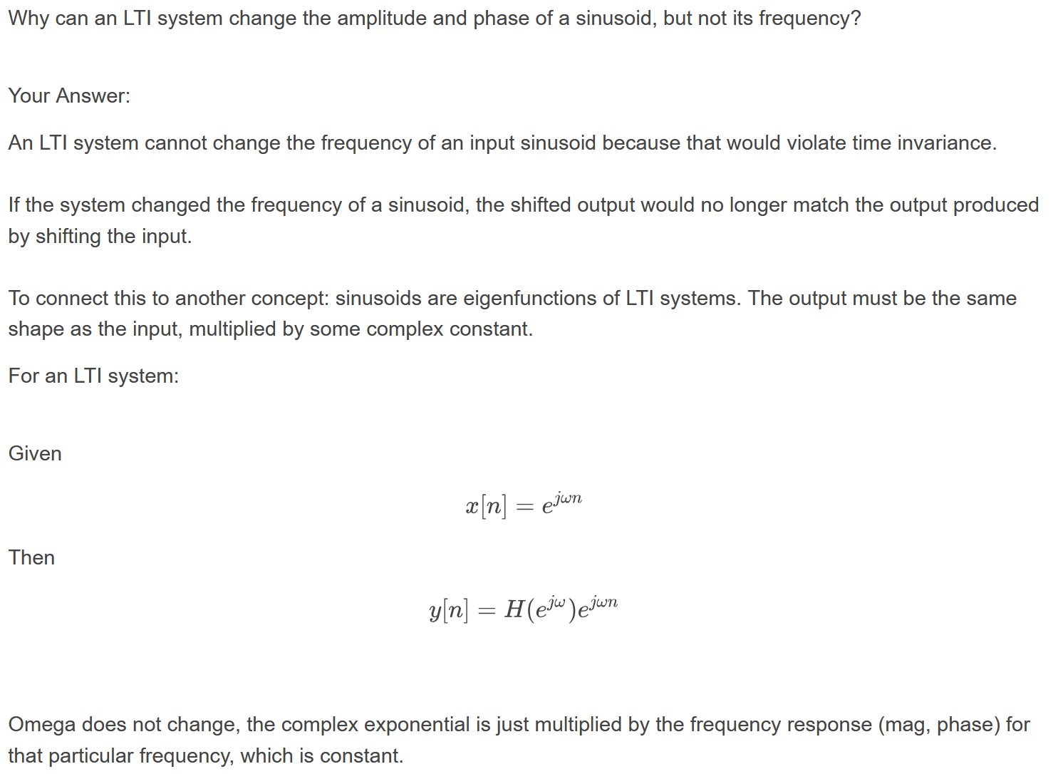
Exit ticket answers have to be short and to the point

Slide 3
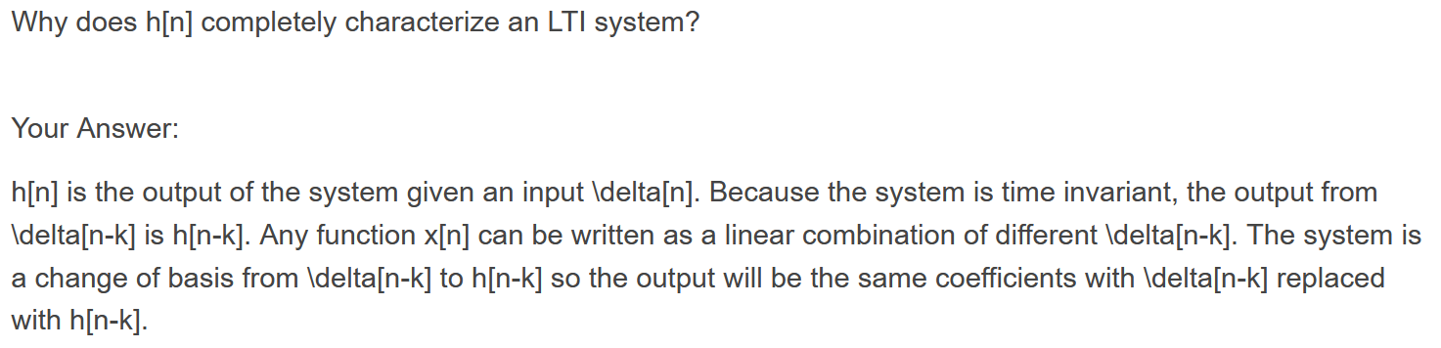
Good answer

Slide 4
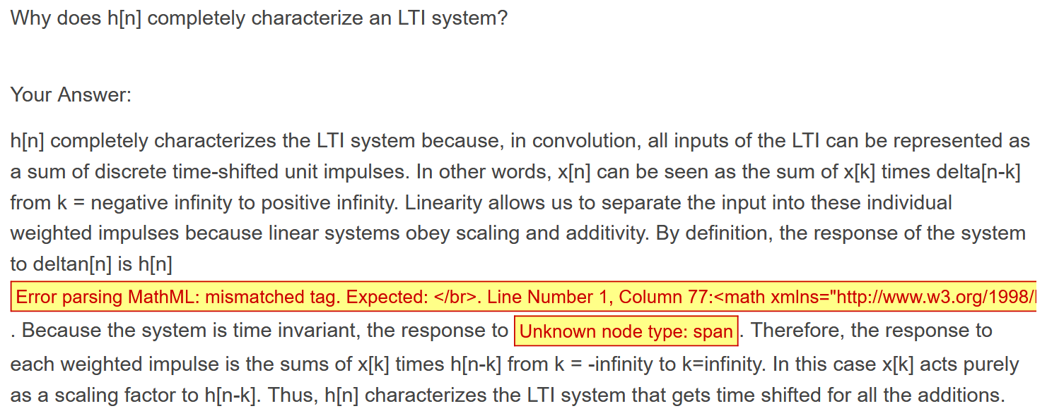
Too wordy, bad formatting

Slide 5
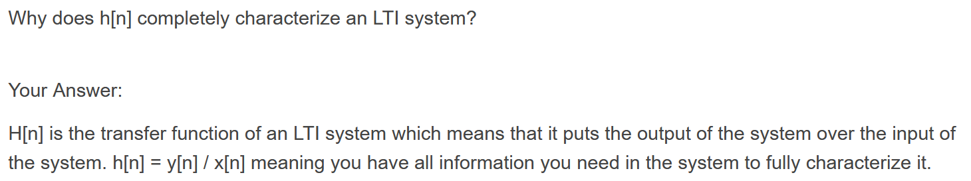
This is a short but incorrect answer

